Slide 1
Fire Suit
Group 10
KENITH Dykes
Linsey Laloy
Zach anderson

Slide 2
Summary
The fire suit aims to upgrade a firefighter’s suit
CONSISTS OF
Microcontroller
Sensors
Indicators

Slide 3
Relevance
During a rescue or a search mission, firefighters are put in high-pressure situations: the fire suit aims to increase situational awareness
Firefighters face unlistable dangers such as advancing flames, falling structure and limited oxygen

Slide 4
Final Approach
Monitor in real time

Slide 5
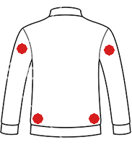
External Temperatures
Four remote sensors mounted on the rear

Slide 6
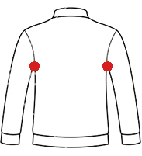
Internal Temperatures
Two remote sensors mounted under arms
Averaged into one reading

Slide 7
Feedback
Two vibration motors mounted
Left and right channels
Indicate dangerous situations
A four RGB-LED chain mounted to wrist
Internal temperature warning
External temperature warning
Emergency exit alert
Notes:
Button will be near LEDs

Slide 8
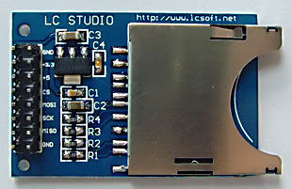
Data Logging
SDHC Card
‘black box’
32gb

Slide 9

Connectivity
Bluetooth to Android
Robust array of sensors
Communication
Intelligent location

Slide 10

Connectivity
Android App
Monitor real-time data
Signal firefighters to exit
Warn of forthcoming danger

Slide 11
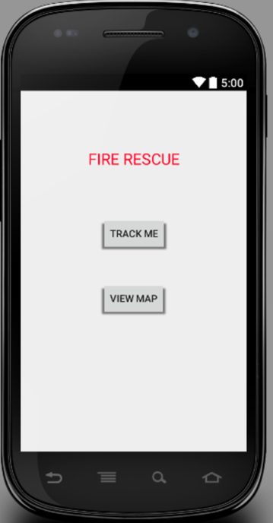
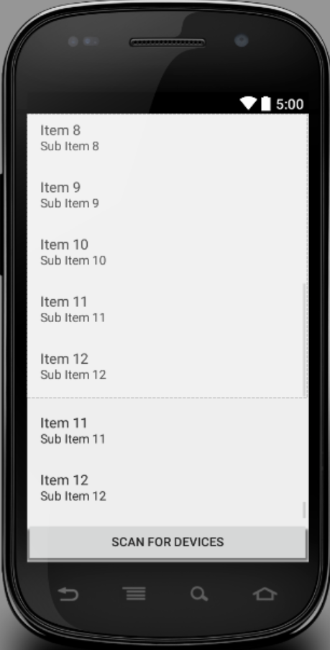
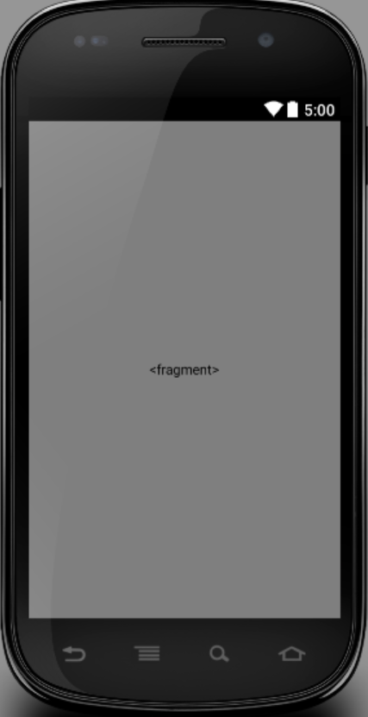
Android Application Prototype
Notes:
First image is the first activity that appears when the application launches,
the second activity appears once the “Track Me” button is selected (intended for firefighter) , and
the third image is selected once the “View Map” activity is selected (Intended for those who wish to monitor the movements of the firefighter)..
App will give user the ability to view the map and watch the movements of everyone who’s paired their vests with their android devices

Slide 12
Challenges
Resources!
7 sensor channels
4 RGB LED channels
2 Vibration channels
SD logging
Bluetooth
RTC

Slide 13
Challenges
Configuration!
Movement
Water
Environment

